Slide 1



Headteacher’s Welcome
15th September 2026

Slide 2




Aims of the meeting
School vision for 2026/2027
Our values
Ways parents, carers, and the wider community can support our school, and be a part of it even more.
Communication
Key events planned for the year
Free School Meals
The exciting journey ahead

Slide 3
Vision for the next year
Priority 1 - To improve children’s writing by reducing barriers to transcription, enabling stronger outcomes in composition.
Priority 2 - To enhance the spiritual development of all pupils through consistent, meaningful Collective Worship, high‑quality teaching and learning in RE, and the active promotion of our Christian vision and values.
Priority 3 To ensure all our children feel safe in school and have good attendance.

Slide 4
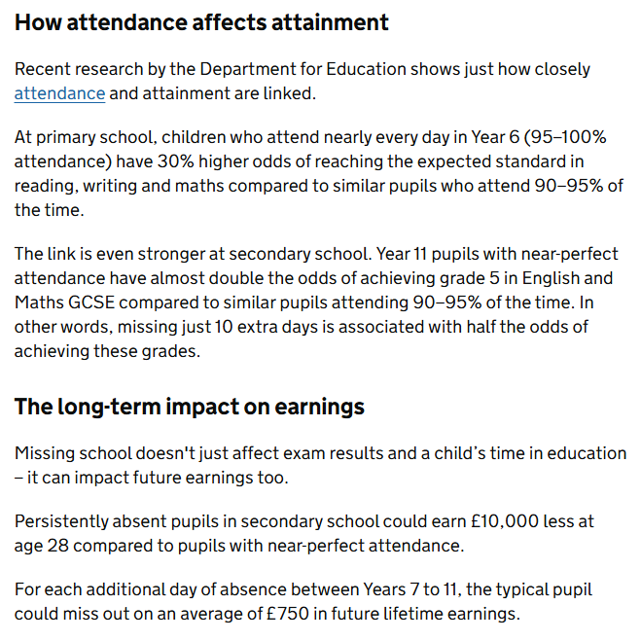
Why Attendance Matters

Slide 5



Values
Love
Courage
Hope
Values Survey

Slide 6
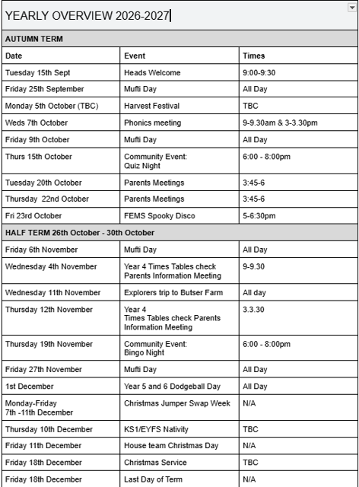
Spring Events
SPRING TERM
4th January | Inset: Spiritual Development | Diocese All day
15th - 18th March | Mock SATS | Mon-Thurs
19th March | House Team Easter Day | All day - rotate round 4 activities
16th March | Parents Meeting | 3.45-6pm
18th March | Parents Meeting | 3.45-6pm
Thursday 25th March | Last Day of Term
Summer Events
SUMMER TERM
12th April | Inset:
10th May | SATS Week | Mon-Thurs
8th June | Multiplication check | All Week
8th July | KS2 Summer Performance | 5.30-6.30pm
12th July - 16th July | Challenge Week
15th July | Sports Day | All day (Parents for picnic lunch and PM)
16th July | House team Spirituality Day | All Day - rotate round 4 activities
Wednesday 22nd july | Inset: Last Day of term

Slide 7



Slide 8


Free School Meals
From September 2026, free school meal eligibility in England expands so that all children in households receiving Universal Credit qualify, regardless of household income

Slide 9
Free School Meals - Key Eligibility Details
Universal Credit: All families on Universal Credit can now claim free school meals, removing the previous £7,400 net earnings threshold.
Universal Infant Free School Meals: All children in Reception, Year 1, and Year 2 in state schools continue to receive free lunches automatically.
No Recourse to Public Funds: Families with no recourse to public funds may still qualify based on specific low-income thresholds.

Slide 10
Free School Meals - How to Apply
Visit the GOV.UK Free School Meals Application page to check details and apply.
Contact us or Hampshire directly if you need help or have specific eligibility questions.

Slide 11
Free School Meals – Why Apply?
Even if your child receives free meals universally you should still register if you receive qualifying benefits so your school can claim extra Pupil Premium funding for educational support.
Each child approved for FSM brings additional funding to the school through the Pupil Premium grant:
Primary schools: Approximately £1,480 per eligible pupil per year (2026 rate).
This funding supports teaching, enrichment, and pastoral initiatives that benefit all children, not just those receiving FSM.
It takes 5-10 minutes to complete online.

Slide 12

Food tasting
The food in school is delivered by Chartwells. The menu is on our website and is soon to change to the Winter menu.
Please take some time to sample some of the cooking that the children enjoy at school.

Slide 13
Communication
ENQUIRY
CONCERN
COMPLAINT
If you need to communicate to staff beyond a few moments at the class door, please send an email to the relevant member of the team:
If you wish to make an enquiry, please send an email to the class teacher or office staff with ENQUIRY in the subject heading
If you are concerned about something, email me at mpenarroja@eastmeonprimary.co.uk with the word CONCERN In the subject heading.
If you wish to make a formal complaint then please follow the procedure as presented in the Complaints Policy, which is on our website.
Please note that staff working hours are mainly between 8-6, so any emails sent outside of these hours will not be read or answered.

Slide 14

FEMS Update
The AGM is no long on 2nd October but likely to be either 28th or 29th September. If you would like to attend, then please let us know: mpenarroja@eastmeonprimary.co.uk sofie.blood@gmail.com

Slide 15
The Journey Ahead
What we are doing well:
Safeguarding
Christian ethos
Attitudes to learning
Pupil outcomes
High-quality teaching
Behaviour
Happy children
Planning and delivery of curriculum
Community links and relationships, particularly our PTA (FEMS)
Communication with all stakeholders

Slide 16
The Journey Ahead
Things we could do better:
SEND interventions
Transitional points – Year R going to Year 1 and Year 2 going to Year 3
Attendance
Transcription skills (handwriting, spelling, grammar)
The spiritual development of our children – please look out for an invite to Collective Worship.
Greater Social Media presence

Slide 17
Vision for the next year
Priority 1 - To improve children’s writing by reducing barriers to transcription, enabling stronger outcomes in composition.
Priority 2 - To enhance the spiritual development of all pupils through consistent, meaningful Collective Worship, high‑quality teaching and learning in RE, and the active promotion of our Christian vision and values.
Priority 3 - To ensure all our children feel safe in school and have good attendance.

Slide 18
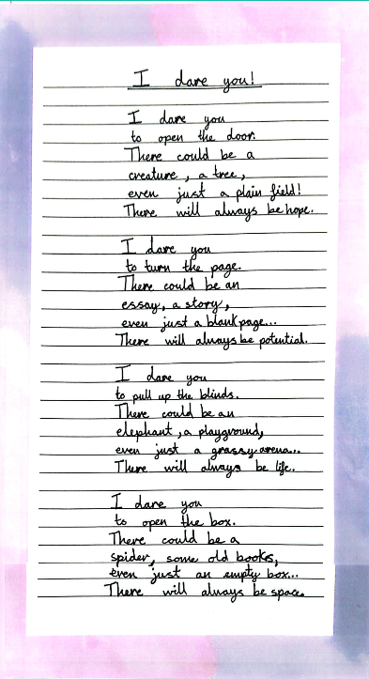
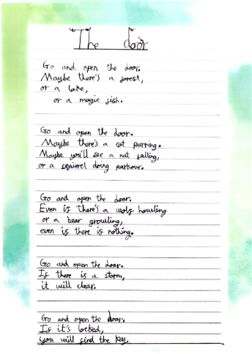
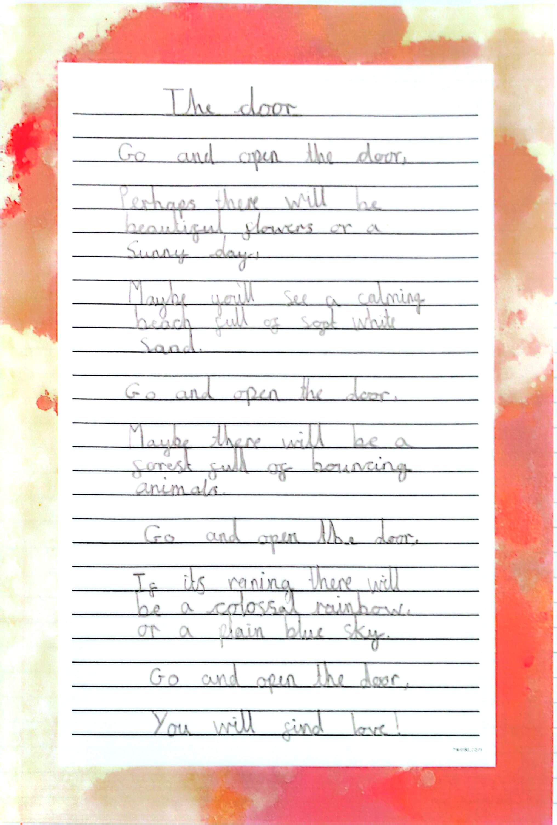

Slide 19
Student Leadership – School Council Roles
Head Boy/Head Girl (Year 6)
Collective Worship Leaders
Global Ambassador
Eco-Warrior
Librarian
Playtime Leader

Slide 20
Collective Worship
Our values drive the theme of the week
We would like to invite parents in to join in our Collective Worship
Our children become active participants

Slide 21
Being safe
Our premises is becoming more secure
Staff have been trained in latest Safeguarding procedures
Staff have had up to date First Aid training
All staff are completing anaphylaxis training in accordance to Benedict’s Law, which has come into effect this month.
A new Allergy policy is being drafted and will be shared on the website.

Slide 22
Attendance
I hold weekly meetings with Mrs T.
We will monitor absences and I may call parents and carers in to see how the school can support your family in regards to attendance.

Slide 23
Thank you for your time

